Slide 1

Capstone Project-python
Bhagyashree More
Enrollment ID-EN12024077896

Slide 2

TMDB Movie
This dataset contains information about their budget, genres, homepage, keywords, original language, original title, overview, popularity, production companies, production countries, release date, revenue, runtime, spoken languages, status, tagline, title, and vote average.
A production company wants to analyze a movie dataset to identify what kinds of movies perform well in cinemas. which genres they belong to and so on.

Slide 3

Objective
The objective of the project is to use Python programming to analyze a movie data to perform exploratory data analysis by answering the questions in the upcoming slides.

Slide 4
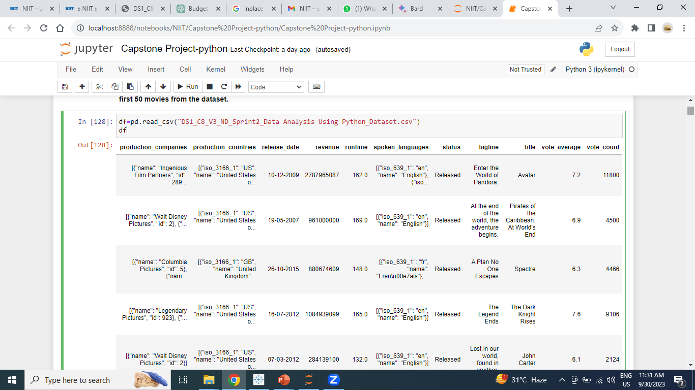
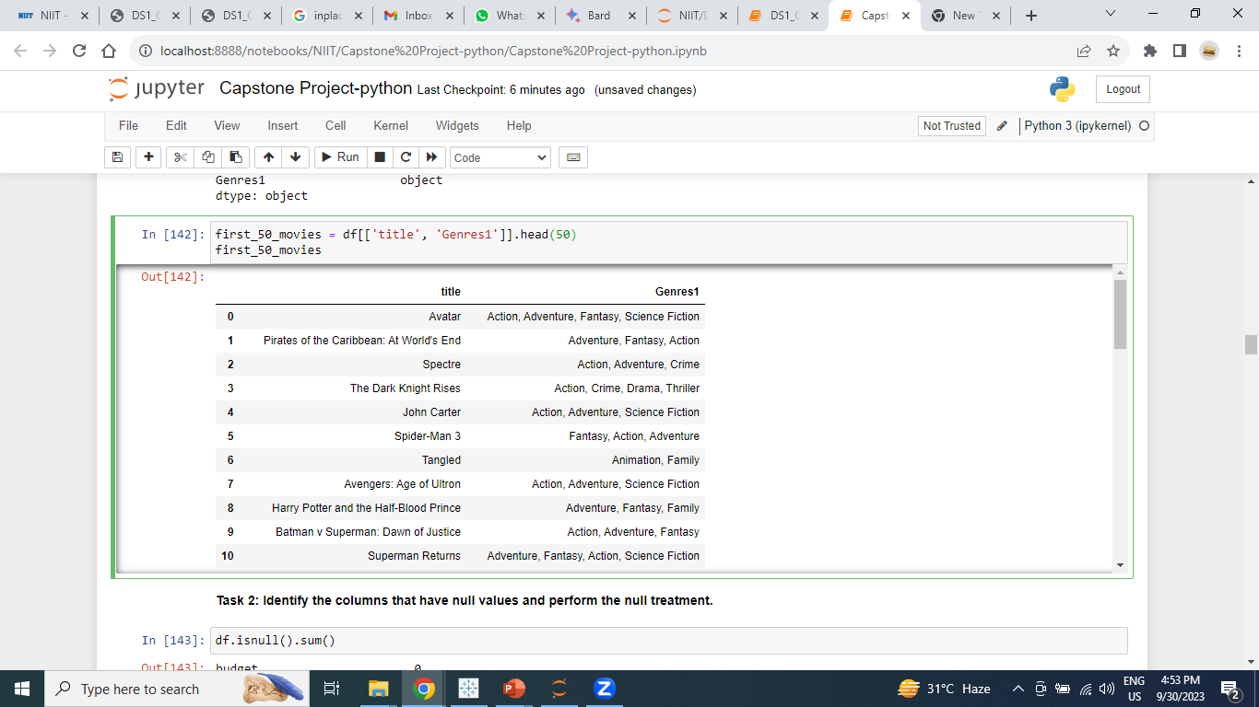
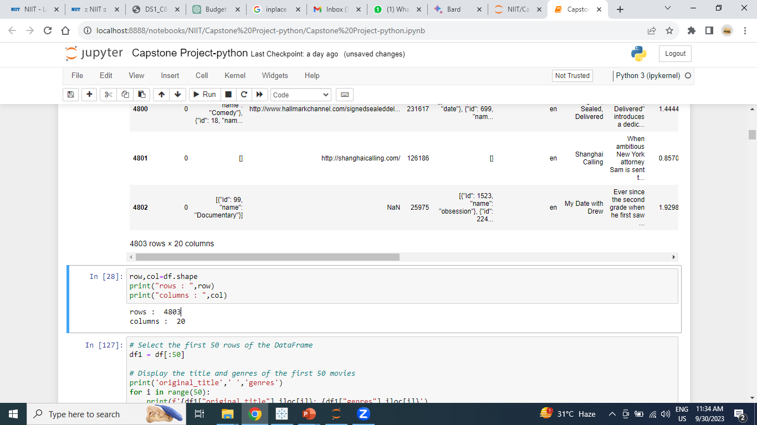
Task 1: Load the movie dataset in the python notebook. display the numbers of rows and columns in the dataset. Display the title and genres of the first 50 movies from the dataset.
Conclusion : Total number of rows are 4803 and columns are 20.

Slide 5
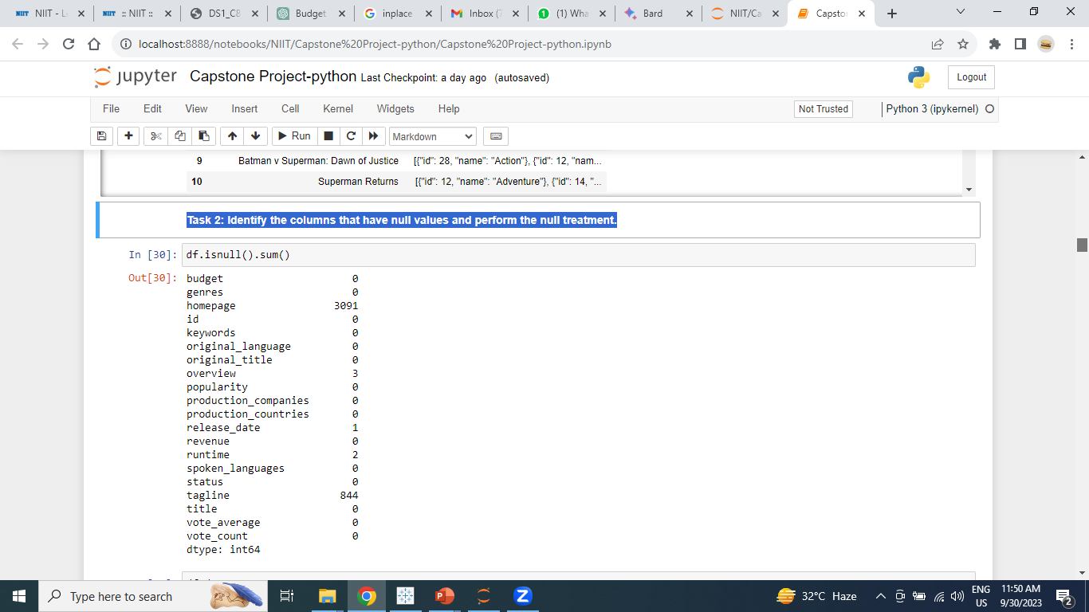
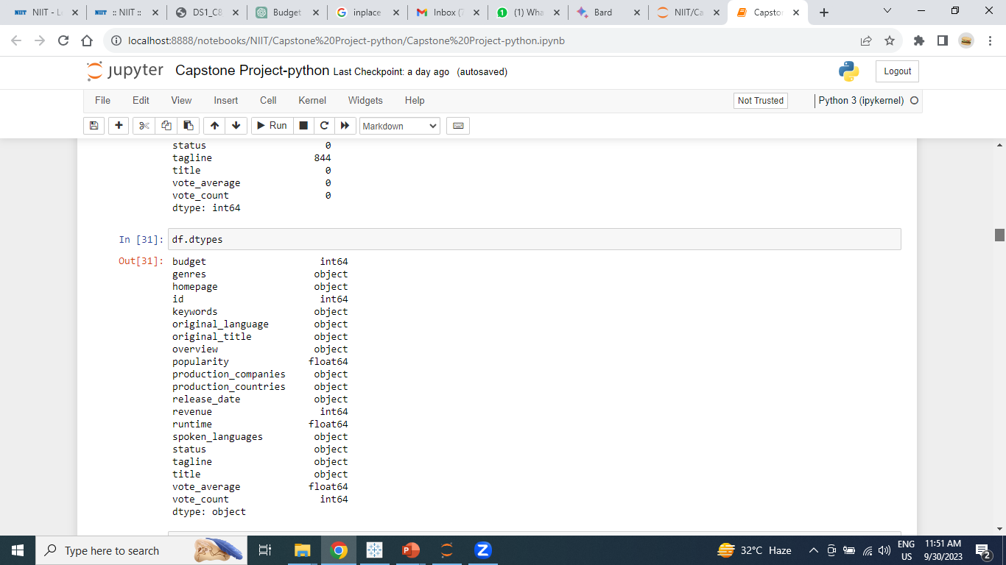
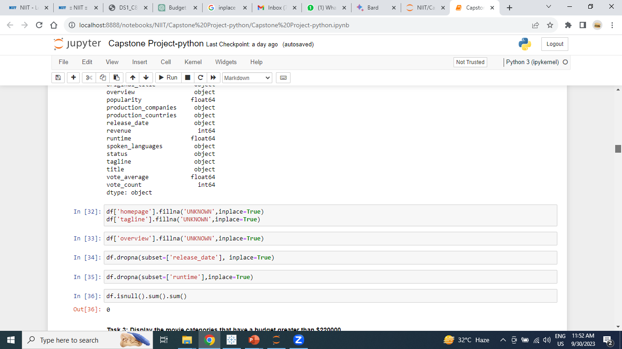
Task 2: Identify the columns that have null values and perform the null treatment.
Conclusion: In homepage and tagline have null value. Using fillna() to fill null value and dropna() using drop the records.

Slide 6
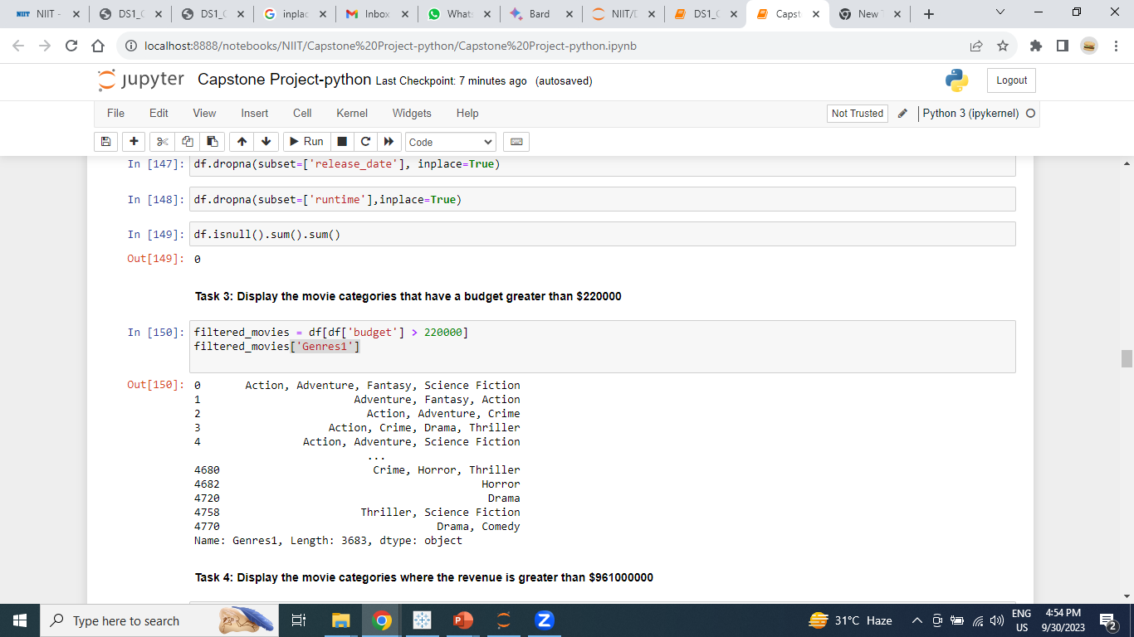
Task 3: Display the movie categories that have a budget greater than $220000
Conclusion: 3686 movies categories have a budget greater than $220000

Slide 7
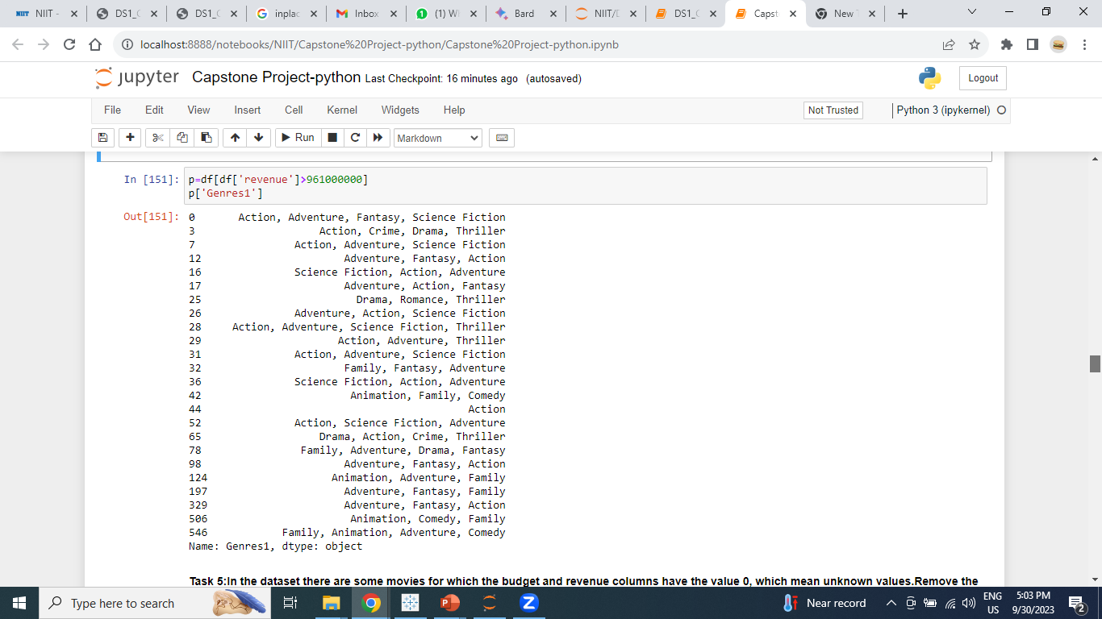
Task 4: Display the movie categories where the revenue is greater than $961000000
Conclusion: only 25 movies categories have a budget greater than $961000000

Slide 8
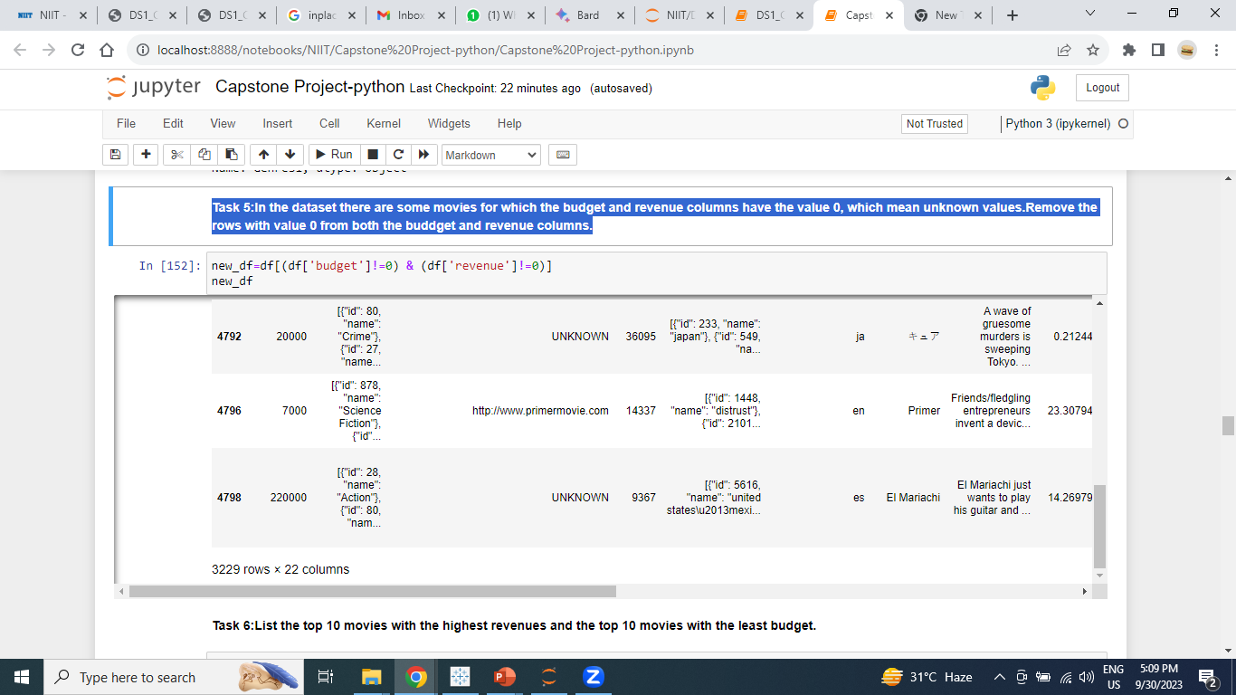
Task 5:In the dataset there are some movies for which the budget and revenue columns have the value 0, which mean unknown values. Remove the rows with value 0 from both the budget and revenue columns.
Conclusion: 3229 rows and 22 columns with new dataframe.

Slide 9
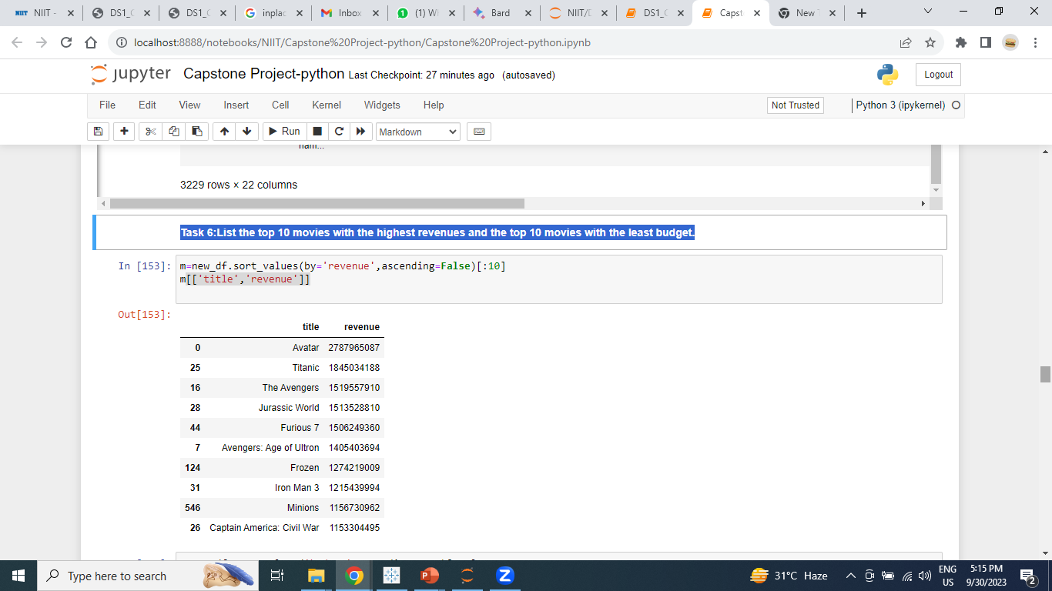
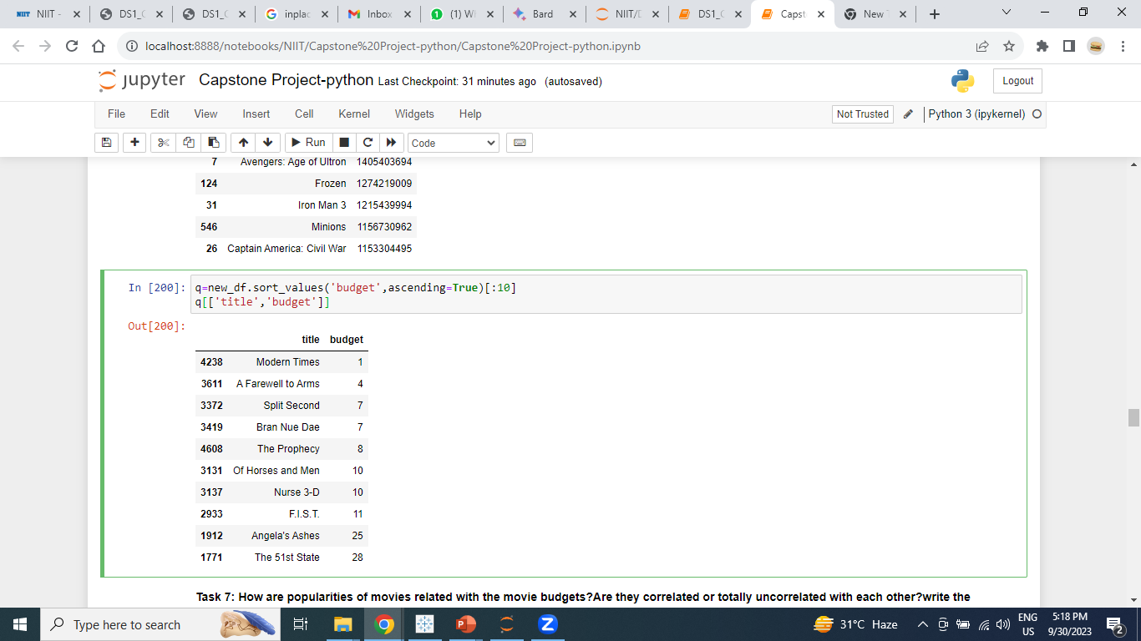
Task 6:List the top 10 movies with the highest revenues and the top 10 movies with the least budget.
Conclusion: Avatar, Titanic, The Avengers movies generated high revenue and modern, A farewell to arms, split second movies make in low budget.

Slide 10
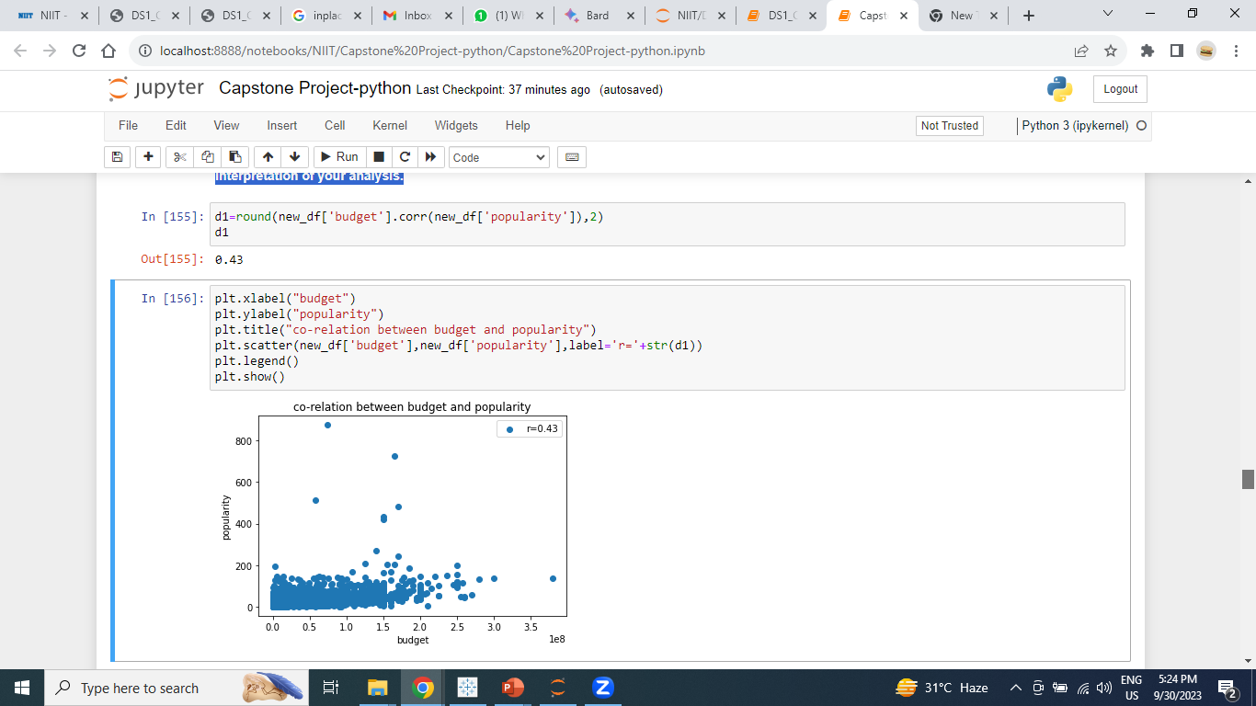
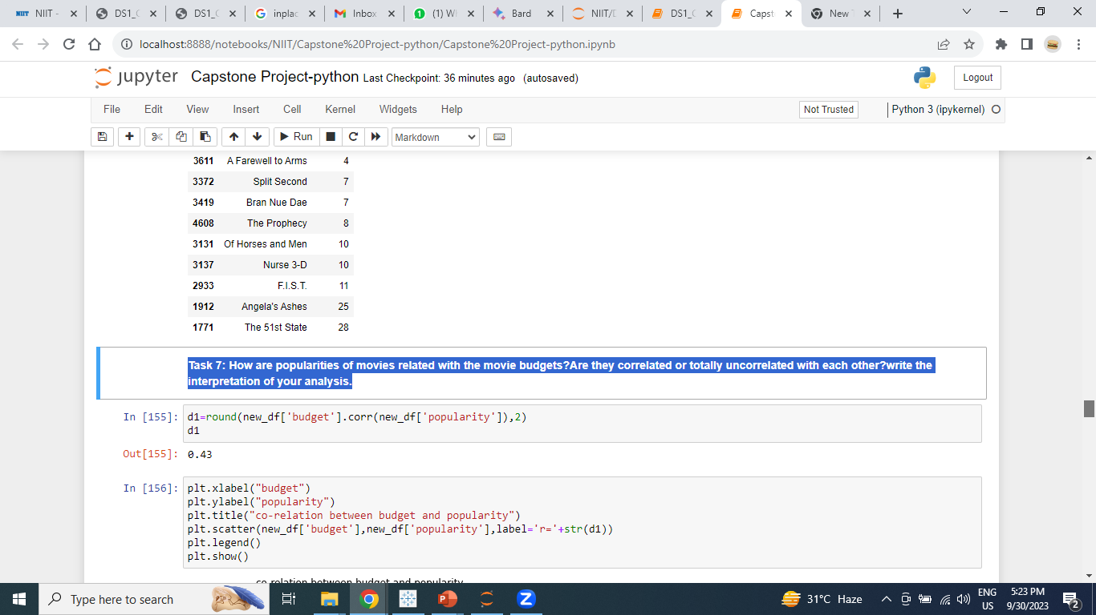
Task 7: How are popularities of movies related with the movie budgets?Are they correlated or totally uncorrelated with each other? write the interpretation of your analysis.
Conclusion: Movie budgets and popularity are correlated, but not perfectly. There is a moderate positive correlation (0.43) between movie budgets and movie popularity. This suggests that, on average, movies with higher budgets tend to be more popular. However, other factors also play a significant role in a movie's success, and budget alone does not guarantee popularity.

Slide 11
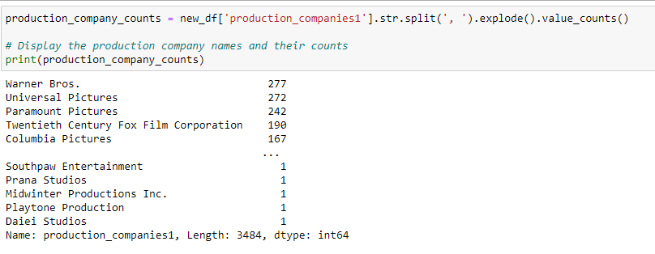
Task 8: Identify and display the names of all production companies along with the number of times they appears in the dataset.
Conclusion: Warner Bros, Universal Pictures, Paramount Pictures production companies are appears multiple times.

Slide 12
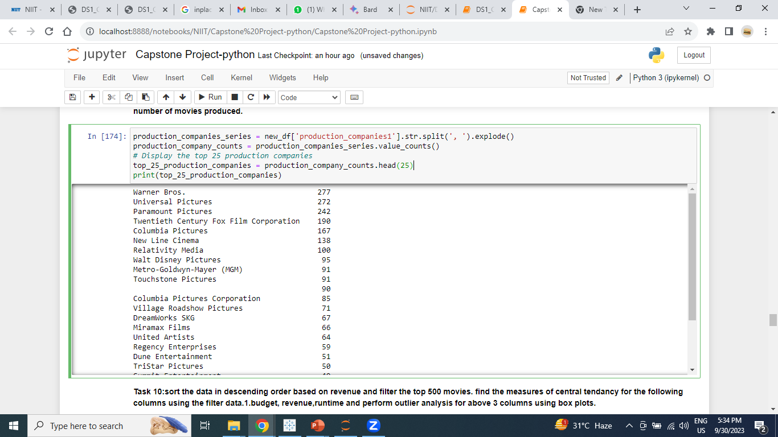
Task 9: Display the names of the top 25 production companies based on the number of movies by have produced in descending order of the number of movies produced.
Conclusion: There are top 25 production companies based on number of movies in descending order.

Slide 13
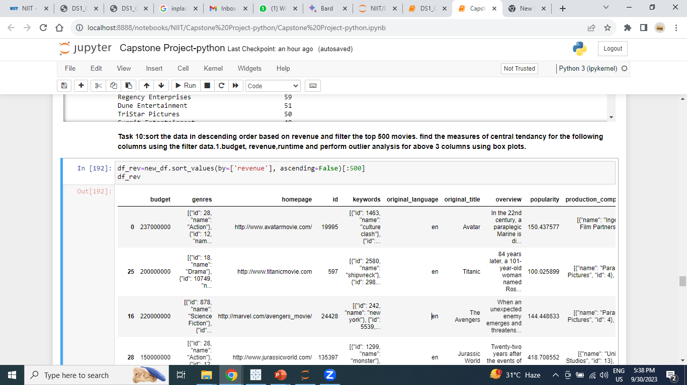
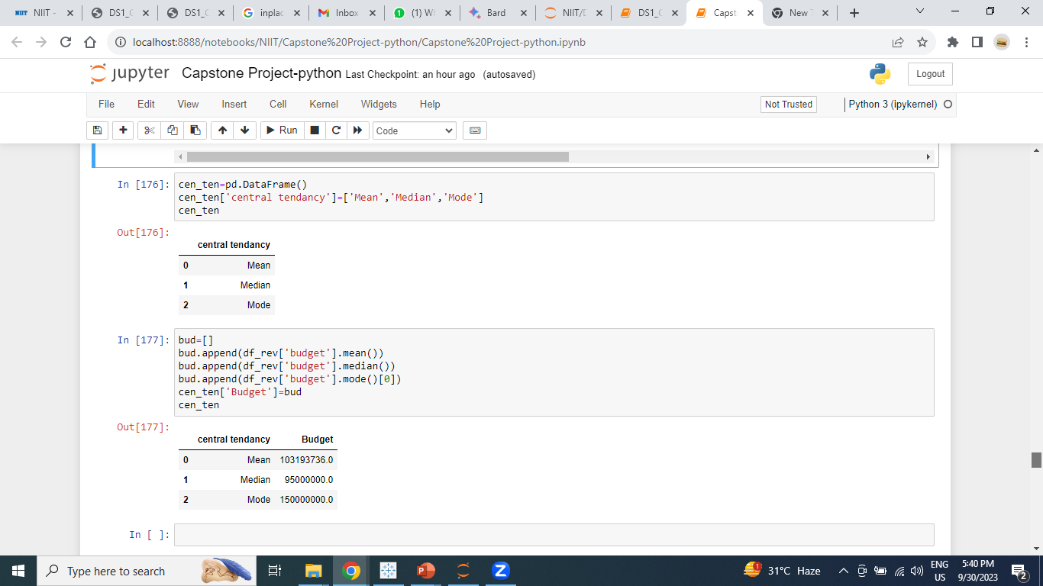
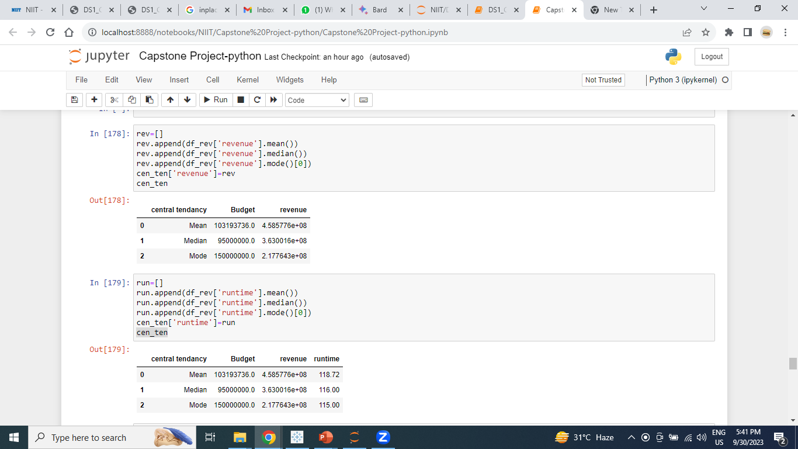
Task 10:sort the data in descending order based on revenue and filter the top 500 movies. find the measures of central tendency for the following columns using the filter data.1.budget, revenue, runtime and perform outlier analysis for above 3 columns using box plots.

Slide 14

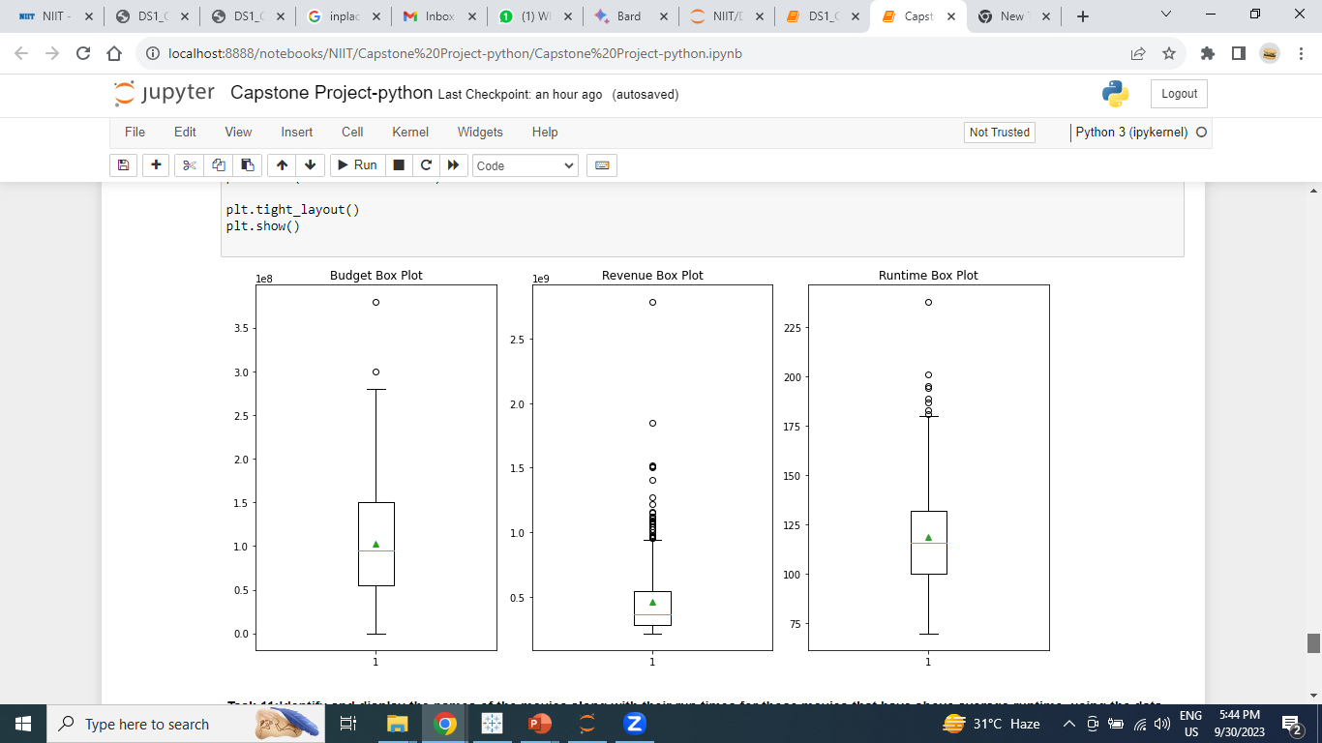
Find Out outlier using Box Plot
Conclusion: In Revenue column have more outliers.

Slide 15

Task 11:Identify and display the names of the movies along with their run times for those movies that have above average runtime, using the data from the previous task.
Conclusion: 234 movies have above 118.72 average runtime.

Slide 16

Conclusion
Overall, the dataset is a large and comprehensive collection of information about movies. It contains 4803 movies with 20 features, including budget, popularity, revenue, and production company.
Blockbuster movies with high budgets from major production companies are more likely to be successful.
Action, adventure, fantasy, thriller, and science fiction are the most revenue-generating movie categories.
Movie budgets and popularity are correlated, but not perfectly.
There are a number of outliers in the revenue column, suggesting that some movies have performed significantly better or worse than expected.
A significant number of movies have above-average runtime.
Overall, the dataset suggests that a movie's success is influenced by a variety of factors, including its genre, budget, production company, and runtime.

Slide 17

Strategies to Increase Revenue
Produce movies in popular genres.
Invest in high production values.
Partner with major production companies.
Market the movie effectively.
Offer a variety of pricing options.
Sell concessions and merchandise.

Slide 18
Thank You

